Slide 1
Leaflet Demonstration
By Ed Rantanen
Notes:
Hello my name is Ed Rantanen, this is Leaflet Demonstration - this will be an elevator pictch – any url can be looked at a later point

Slide 2
Overview
The initial proposal was to use Deep sea data and to build layers across a map that integrated with Bathymetric grid data. This was partially done utilizing with an extend Leaflet library called, Leaflet-elevation. For this exercise profiles are built of the ocean floor by pulling grid data from GEBCO.org. Ocean floor profiles are built as tracks. The amount of time taken for this project did not allow for an integration of the deep sea data set. Even though a pre-process was completed on this data set.

Slide 3
Data Acquisition
Map Imagery https://www.bodc.ac.uk/data/open_download/gebco/gebco_2023_sub_ice_topo/geotiff/ (each Tiff approx. 500M within zip) User Defined - https://download.gebco.net/
Dimensional Data https://www.bodc.ac.uk/data/open_download/ibcao/ibcao_v4_2_13_400m/cfnetcdf/
Scientific Data – Oceanographic https://calcofi.org/data/oceanographic-data/bottle-database/
Notes:
British Oceanographic Data Centre – geotif and grid data in a netcdf format
California Cooperative Oceanic Fisheries Investigations

Slide 4
Tools and Libraries
Python
netCDF4
numpy
csv
pandas
Gpx-converter
simplekml
gpx2kml
JavaScript
Leaflet
Leaflet-elevation
Tools
QGIS
docker
npm
GeoServer
Notes:
Tools and libraries used – Docker/NPM/geoserver - running as a system – utilizing different ports.

Slide 5
1st Pre-Processing Imagery
First dataset pulled from GEBCO 8Gb, each tiff approx. 500M
Tiles built – Vancouver to Mexico, Linkage of tiles based on a type of binary tree
Red-Black Tree - noted for fast storage and retrieval of ordered information
Range of elevation +2000m to -5000m
With 0 being sea level
Tiles and Overhead required prohibitive for AWS
Notes:
Tile to scale issue with range - investigation of sizing

Slide 6
2nd Pre-Processing Imagery
AWS – cost model drove 2nd series of tile builds
GEBCO - User defined geotiff 10M vs 500M per Tiff
Range of tiles based on elevation needs separation.
SLD built to distinguish features
User defined classification with 11 elevation catagories
Notes:
Sld

Slide 7
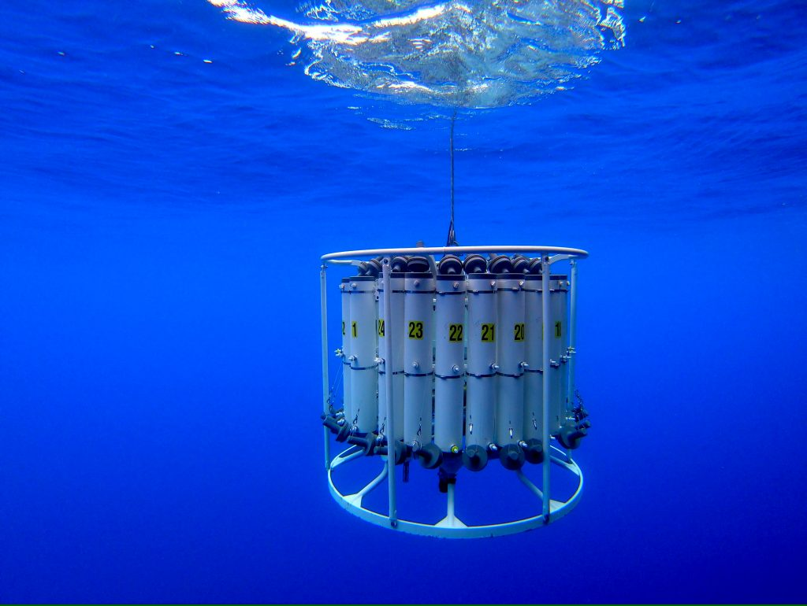
Pre-Processing Data and git repo
CaliCOFI – Sample Data https://github.com/erantanen/salinity_investigation
GEBCO – Grid Data https://github.com/erantanen/leaflet-salinity
GEBCO - Imagery
Notes:
The image shows a sensor array with depth triggered sampleling -- 2nd image shows the basic geo tiff utilized as a black and white image

Slide 8
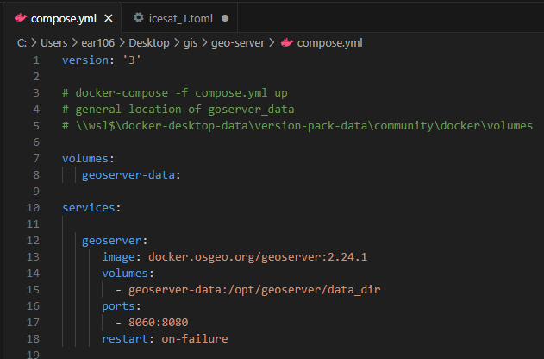
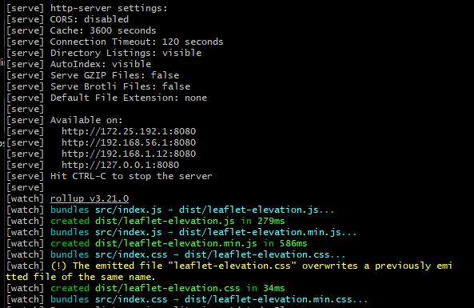
Live Demo
docker - geoserver
npm – http-server
github - versioned code
Notes:
Show docker interface and npm -

Slide 9
Follow on?
Build visualization as time series
Extend data handlers
Extend handler to include min/max feature
Possible integration with Leaflet-Velocity

